Slide 1
LnuF ROCker model summary

Slide 2
Model 1
LnuF Clade positive
All other clades negative

Slide 3
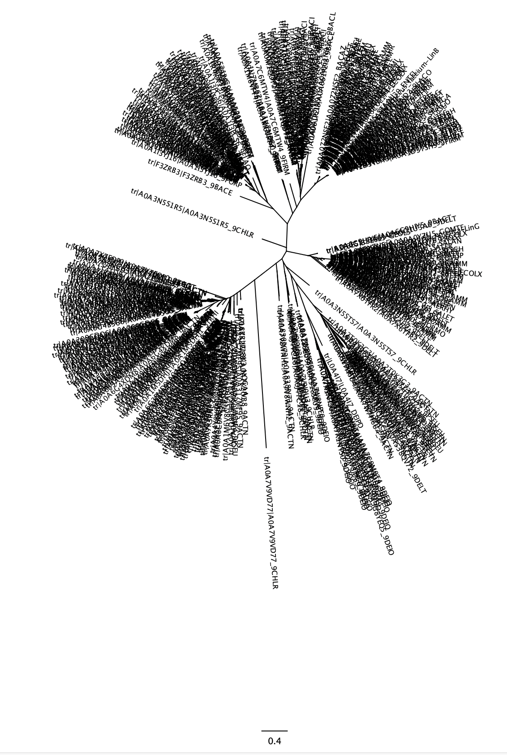
Clade 4 (1/34)
Clade 3: LnuG (15/32)
K-Means Cluster 7, 17
TrEMBL annotation: Nucleotidyltransferase
Paenibafillus, Oceanobacillus, Geomicrobium, etc.
K-Means Cluster 3
Lincosamide nucleotidyltransferase (LnuG)Enterococcus, Staphylococcus, Ecoli, Salmonella, Proteus, Acinetobacter, Listeria, etc
Clade 5 (19/59)
Clade 2: LnuB (22/41)
K-Means Cluster 1, 14, 16
TrEMBL annotation: LnuF
Myroides, Flavobacterium, Empedobacter, Bacteroidales
K-Means Cluster 13
Lincosamide nucleotidyltransferase (LnuB)
Enterococcus, Sptreptococcus, Lactobacillus, Clostriduim, etc.
Cluster 10
Clade 1: LnuF_1 & LnuF_2 (33/63)
K-Means Cluster 4, 18
Lincosamide nucleotidyltransferase (LnuF)
Salmonella, Ecoli, Kelbsiella, Providencia, Proteus etc
Model 1: LnuF
Positive
Negative
Clade 1: LnuF_3
Cluster 10
Clade 6 (25/131)
Clade 7 (11/56)
K-Means Cluster 0, 5, 9 & 15
TrEMBL annotation: DNA Polymerase subunit beta and
Lincosamide nucleotidyltransferase.
Streptomyces
K-Means Cluster 2, 6, 8, 10-12, 19
TrEMBL annotation: Lincosamide nucleotidyltransferase
Actinoplanes, Chloroflexia, Rubrobacteraceae, Delinococcus, Actinobacteria, Streptomyces
Cluster 10
Cluster 11

Slide 4
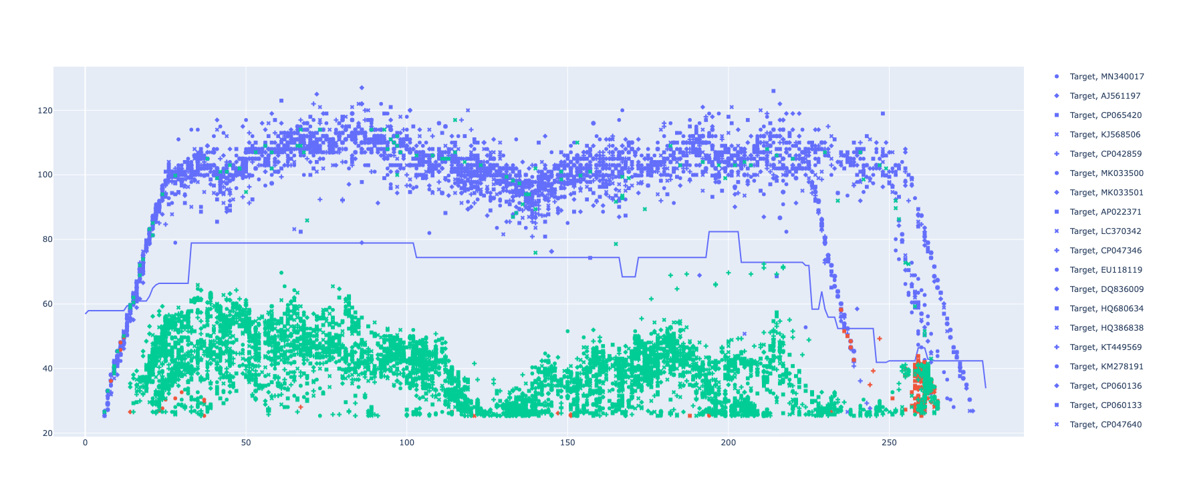
LnuF ROCker model using ROCkOut – 150bp reads

Slide 5
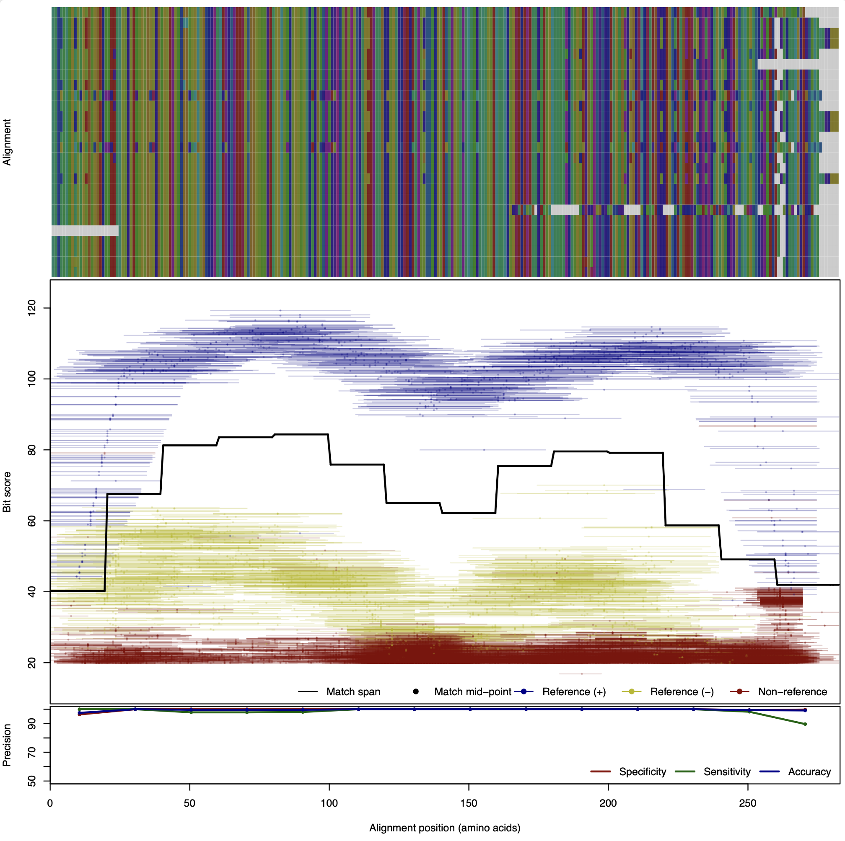
LnuF Model
original ROCker
150bp reads.

Slide 6
Model 2
LnuB Clade positive
All other clades negative

Slide 7
Clade 4 (34)
Clade 3: LnuG (32)
K-Means Cluster 7, 17
TrEMBL annotation: Nucleotidyltransferase
Paenibafillus, Oceanobacillus, Geomicrobium, etc.
K-Means Cluster 3
Lincosamide nucleotidyltransferase (LnuG)Enterococcus, Staphylococcus, Ecoli, Salmonella, Proteus, Acinetobacter, Listeria, etc
Clade 5 (59)
Clade 2: LnuB (41)
K-Means Cluster 1, 14, 16
TrEMBL annotation: LnuF
Myroides, Flavobacterium, Empedobacter, Bacteroidales
K-Means Cluster 13
Lincosamide nucleotidyltransferase (LnuB)
Enterococcus, Sptreptococcus, Lactobacillus, Clostriduim, etc.
Cluster 10
Clade 1: LnuF_1 & LnuF_2 (63)
K-Means Cluster 4, 18
Lincosamide nucleotidyltransferase (LnuF)
Salmonella, Ecoli, Kelbsiella, Providencia, Proteus etc
Model 1: LnuF
Positive
Negative
Clade 1: LnuF_3
Cluster 10
Clade 6 (131)
Clade 7 (56)
K-Means Cluster 0, 5, 9 & 15
TrEMBL annotation: DNA Polymerase subunit beta and
Lincosamide nucleotidyltransferase.
Streptomyces
K-Means Cluster 2, 6, 8, 10-12, 19
TrEMBL annotation: Lincosamide nucleotidyltransferase
Actinoplanes, Chloroflexia, Rubrobacteraceae, Delinococcus, Actinobacteria, Streptomyces
Cluster 10
Cluster 11

Slide 8
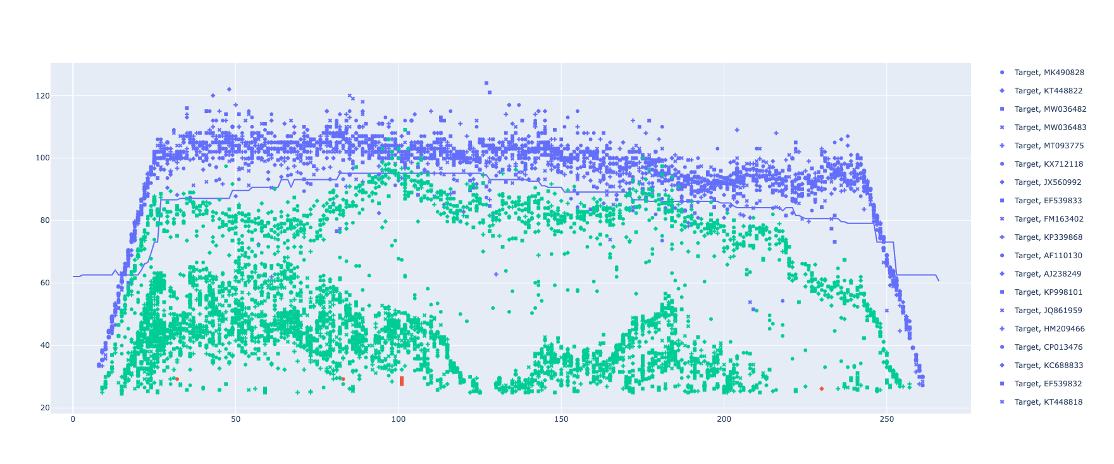
LnuB ROCker model using ROCkOut – 150bp reads

Slide 9
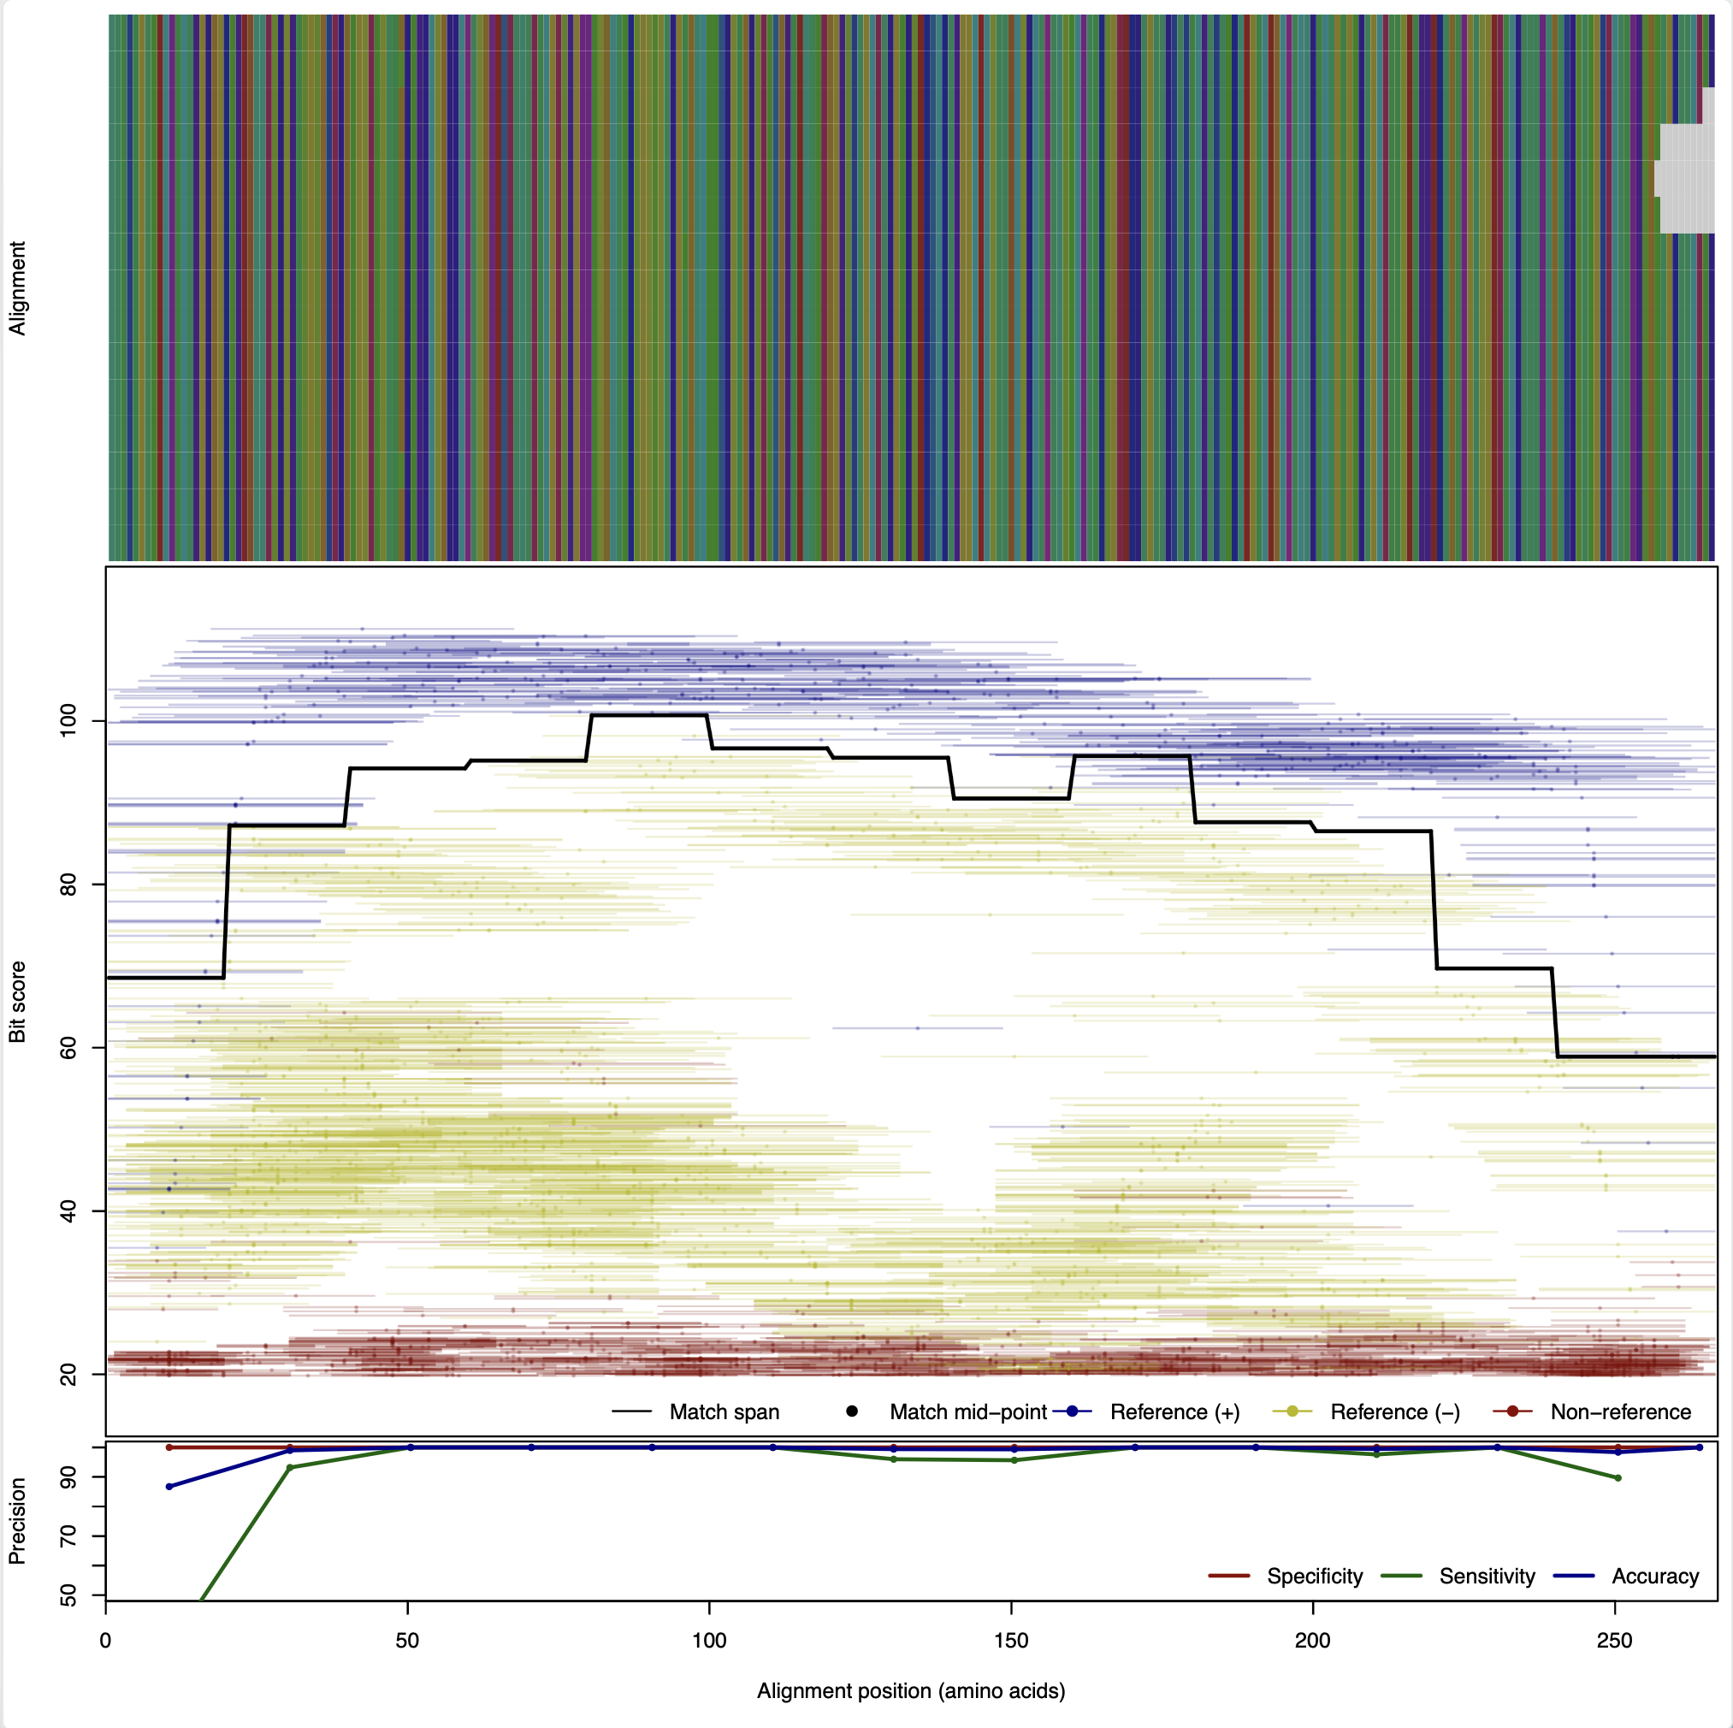
LnuB Model
original ROCker
150bp reads.

Slide 10
Model 3
LnuG Clade positive
All other clades negative

Slide 11
Clade 4 (34)
Clade 3: LnuG (32)
K-Means Cluster 7, 17
TrEMBL annotation: Nucleotidyltransferase
Paenibafillus, Oceanobacillus, Geomicrobium, etc.
K-Means Cluster 3
Lincosamide nucleotidyltransferase (LnuG)Enterococcus, Staphylococcus, Ecoli, Salmonella, Proteus, Acinetobacter, Listeria, etc
Clade 5 (59)
Clade 2: LnuB (41)
K-Means Cluster 1, 14, 16
TrEMBL annotation: LnuF
Myroides, Flavobacterium, Empedobacter, Bacteroidales
K-Means Cluster 13
Lincosamide nucleotidyltransferase (LnuB)
Enterococcus, Sptreptococcus, Lactobacillus, Clostriduim, etc.
Cluster 10
Clade 1: LnuF_1 & LnuF_2 (63)
K-Means Cluster 4, 18
Lincosamide nucleotidyltransferase (LnuF)
Salmonella, Ecoli, Kelbsiella, Providencia, Proteus etc
Model 1: LnuF
Positive
Negative
Clade 1: LnuF_3
Cluster 10
Clade 6 (131)
Clade 7 (56)
K-Means Cluster 0, 5, 9 & 15
TrEMBL annotation: DNA Polymerase subunit beta and
Lincosamide nucleotidyltransferase.
Streptomyces
K-Means Cluster 2, 6, 8, 10-12, 19
TrEMBL annotation: Lincosamide nucleotidyltransferase
Actinoplanes, Chloroflexia, Rubrobacteraceae, Delinococcus, Actinobacteria, Streptomyces
Cluster 10
Cluster 11

Slide 12
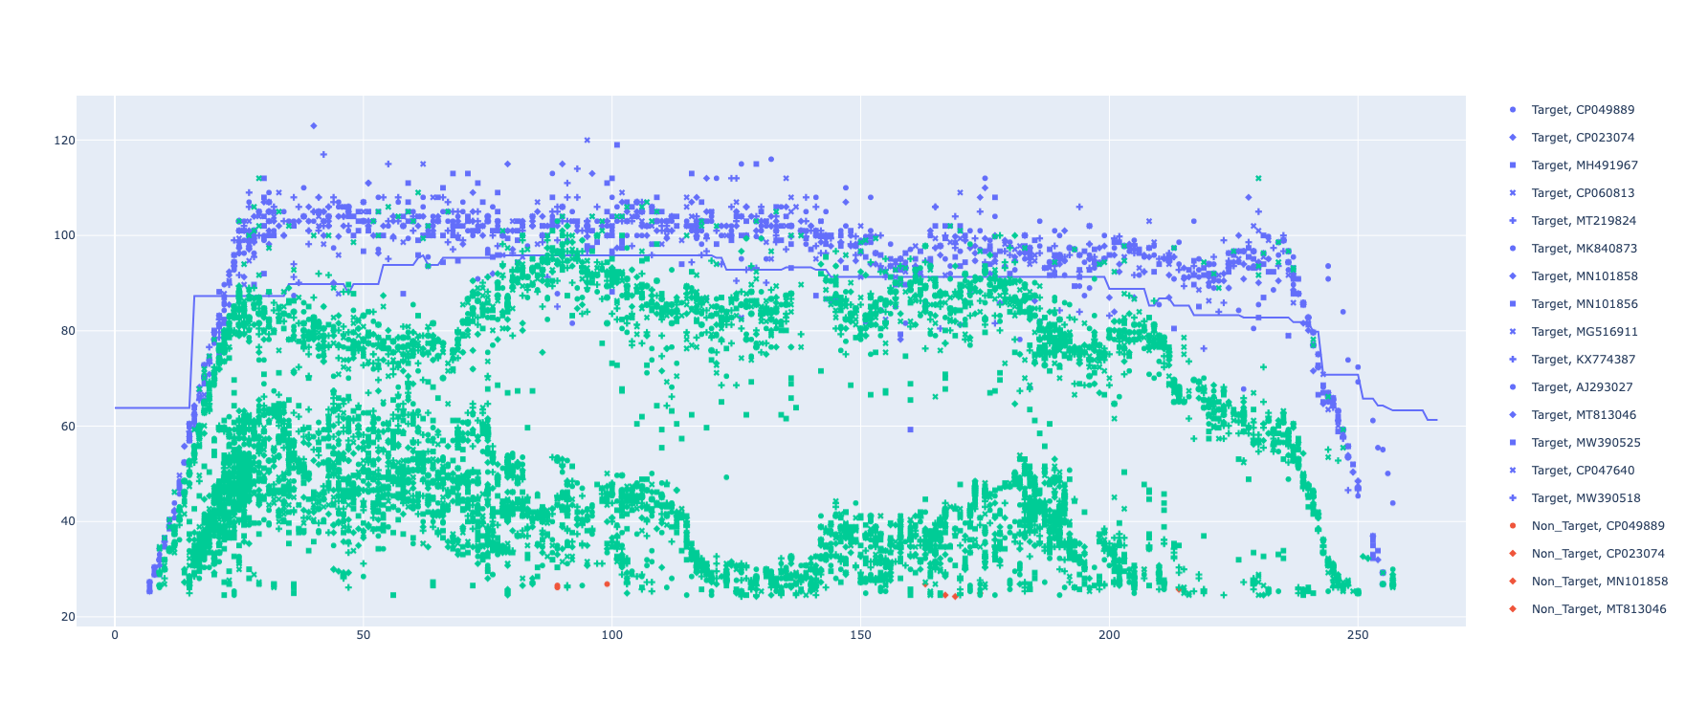
LnuG ROCker model using ROCkOut – 150bp reads

Slide 13
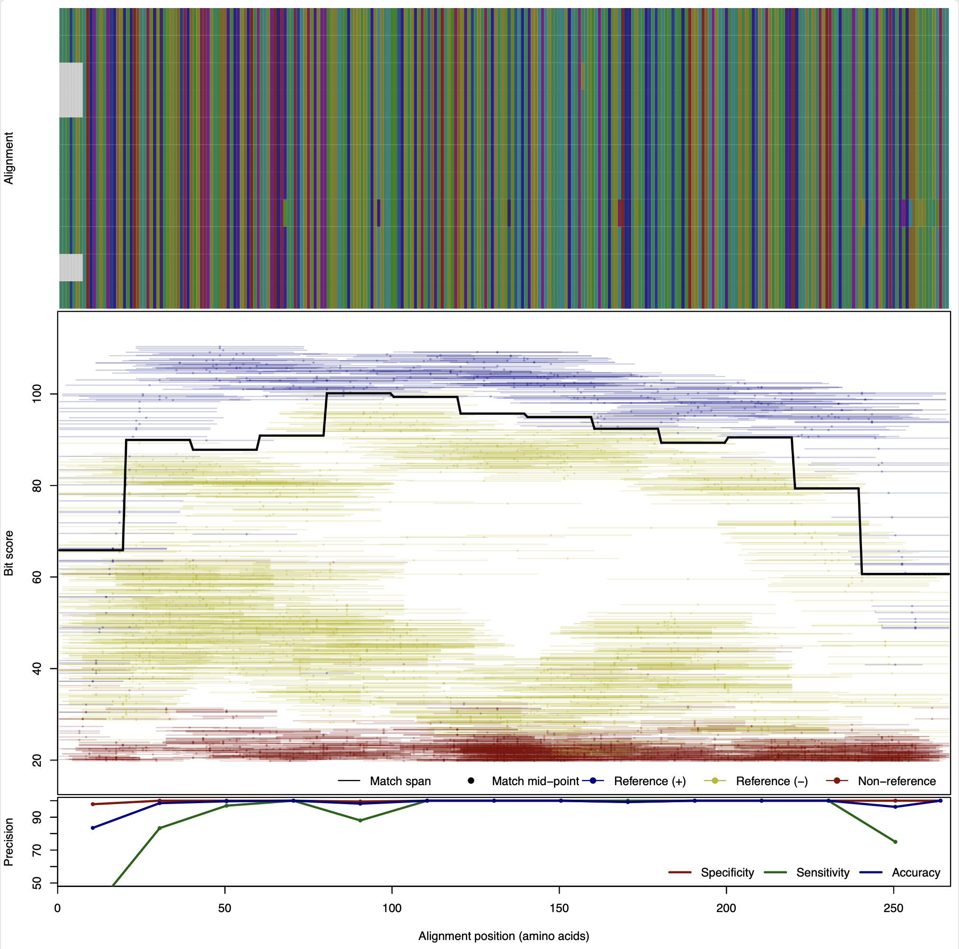
LnuG Model
original ROCker
150bp reads.

Slide 14
Model 4
All Lnu Clades positive
All other clades negative

Slide 15
Clade 4 (34)
Clade 3: LnuG (32)
K-Means Cluster 7, 17
TrEMBL annotation: Nucleotidyltransferase
Paenibafillus, Oceanobacillus, Geomicrobium, etc.
K-Means Cluster 3
Lincosamide nucleotidyltransferase (LnuG)Enterococcus, Staphylococcus, Ecoli, Salmonella, Proteus, Acinetobacter, Listeria, etc
Clade 5 (59)
Clade 2: LnuB (41)
K-Means Cluster 1, 14, 16
TrEMBL annotation: LnuF
Myroides, Flavobacterium, Empedobacter, Bacteroidales
K-Means Cluster 13
Lincosamide nucleotidyltransferase (LnuB)
Enterococcus, Sptreptococcus, Lactobacillus, Clostriduim, etc.
Cluster 10
Clade 1: LnuF_1 & LnuF_2 (63)
K-Means Cluster 4, 18
Lincosamide nucleotidyltransferase (LnuF)
Salmonella, Ecoli, Kelbsiella, Providencia, Proteus etc
Model 2: Lnu
Positive
Negative
Clade 1: LnuF_3
Cluster 10
Clade 6 (131)
Clade 7 (56)
K-Means Cluster 0, 5, 9 & 15
TrEMBL annotation: DNA Polymerase subunit beta and
Lincosamide nucleotidyltransferase.
Streptomyces
K-Means Cluster 2, 6, 8, 10-12, 19
TrEMBL annotation: Lincosamide nucleotidyltransferase
Actinoplanes, Chloroflexia, Rubrobacteraceae, Delinococcus, Actinobacteria, Streptomyces
Cluster 10
Cluster 11

Slide 16
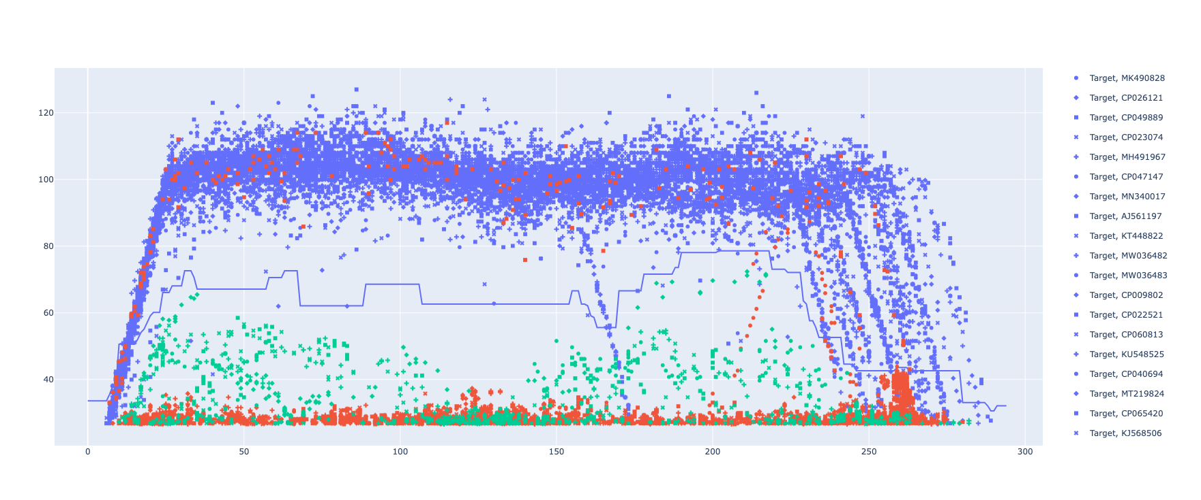
Lnu ROCker model using ROCkOut – 150bp reads

Slide 17
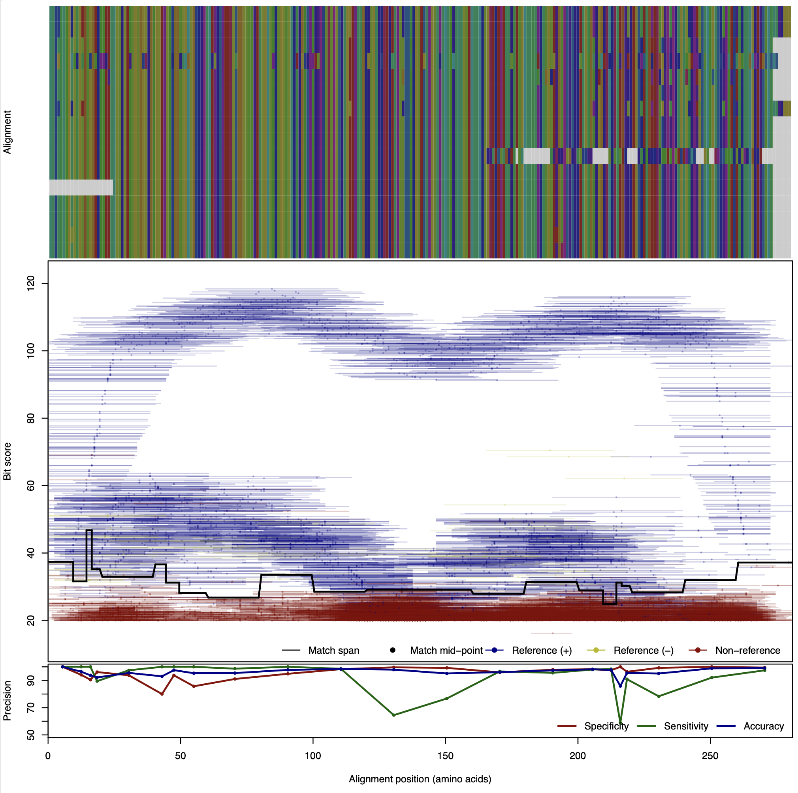
Lnu Model
original ROCker
150bp reads.

